Slide 1
Data Analytics – Lesson 8 Introduction to R Programming
Jeffrey Strickland, Ph.D.

Slide 2

What is Required by Data Analytics?
Integrate
Analyze
Visualize
V1 | V2 | V3 | V4
1 | 14.23 | 1.71 | 2.43
1 | 13.20 | 1.78 | 2.14
1 | 13.16 | 2.36 | 2.67
1 | 14.37 | 1.95 | 2.50
1 | 13.24 | 2.59 | 2.87
https://portal.azure.com/#dashboard/private/6245138c-3a35-4e4f-8cf6-d8fe27b9b026

Slide 3
Iris dataset
Edgar Anderson's Iris Data
Description: This famous (Fisher's or Anderson's) iris data set gives the measurements in centimeters of the variables sepal length and width and petal length and width, respectively, for 50 flowers from each of 3 species of iris. The species are Iris setosa, versicolor, and virginica.
Usage: Iris and iris3
Format: iris is a data frame with 150 cases (rows) and 5 variables (columns) named Sepal.Length, Sepal.Width, Petal.Length, Petal.Width, and Species.
Format: iris3 gives the same data arranged as a 3-dimensional array of size 50 by 4 by 3, as represented by S-PLUS. The first dimension gives the case number within the species subsample, the second the measurements with names Sepal L., Sepal W., Petal L., and Petal W., and the third the species.

Slide 4
Cars Dataset
Speed and Stopping Distances of Cars
Description: The data give the speed of cars and the distances taken to stop. Note that the data were recorded in the 1920s.
Usage: cars
Format:
A data frame with 50 observations on 2 variables.
[,1] speed numeric Speed (mph)
[,2] dist numeric Stopping distance (ft)
Source: Ezekiel, M. (1930) Methods of Correlation Analysis. Wiley.

Slide 5
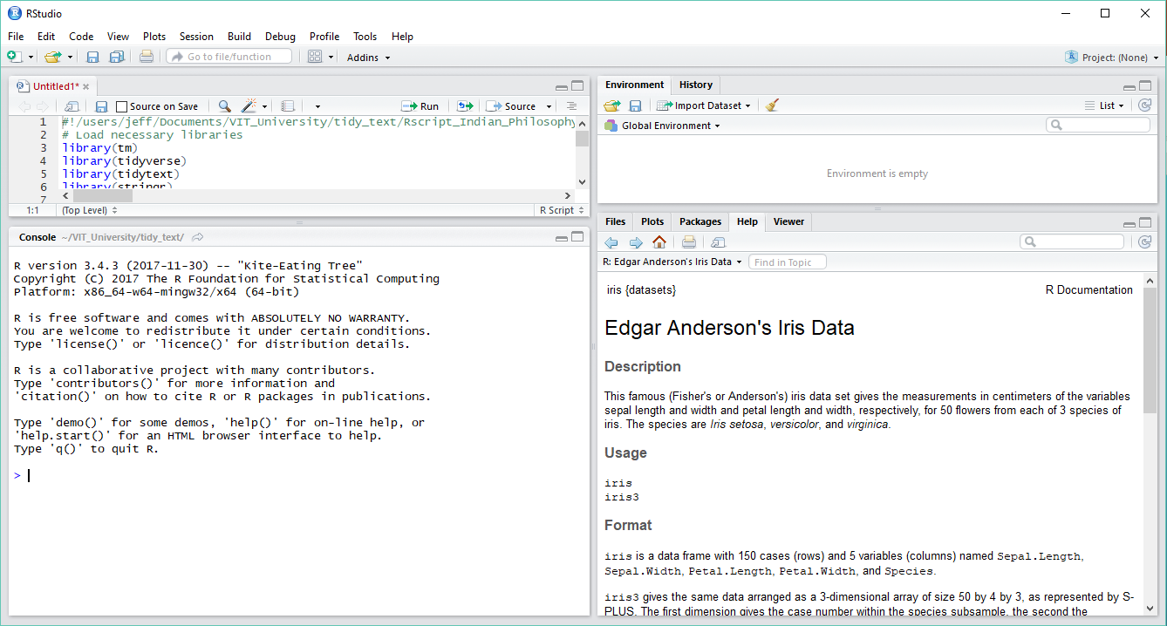
R-Studio

Slide 6
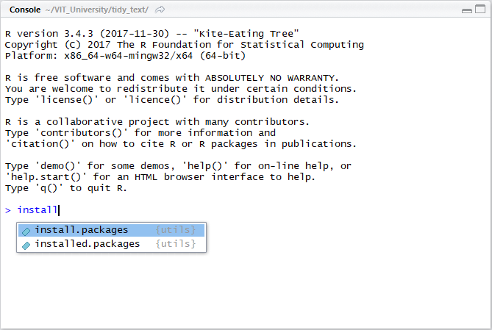
Installing a Package

Slide 7
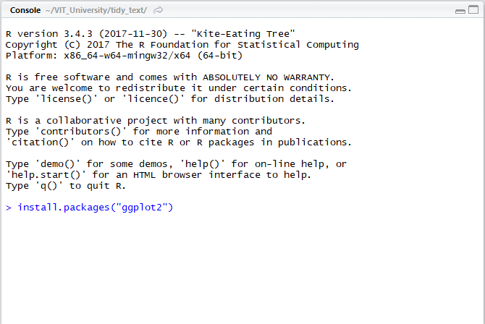
Installing a Package

Slide 8
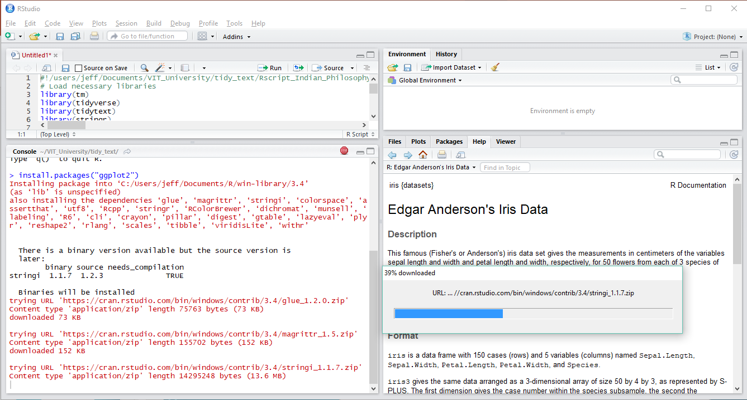
Installing a Package

Slide 9
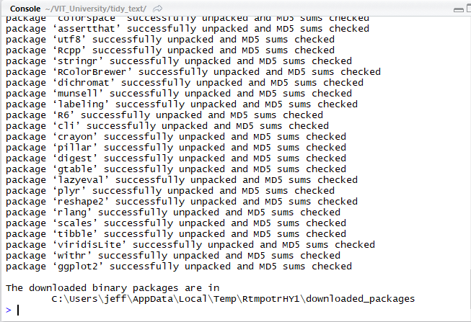
Installing A Package - Dependencies

Slide 10
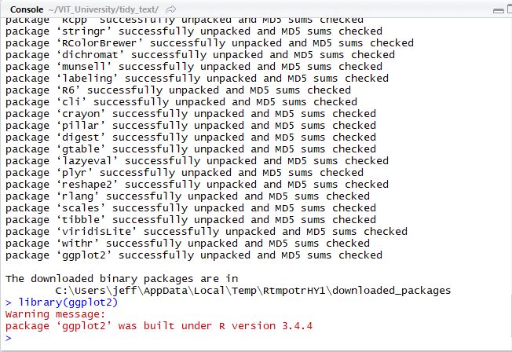
Loading a Library (Package)

Slide 11
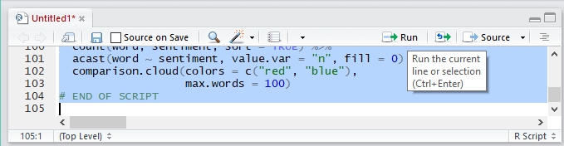
R - Scripts

Slide 12
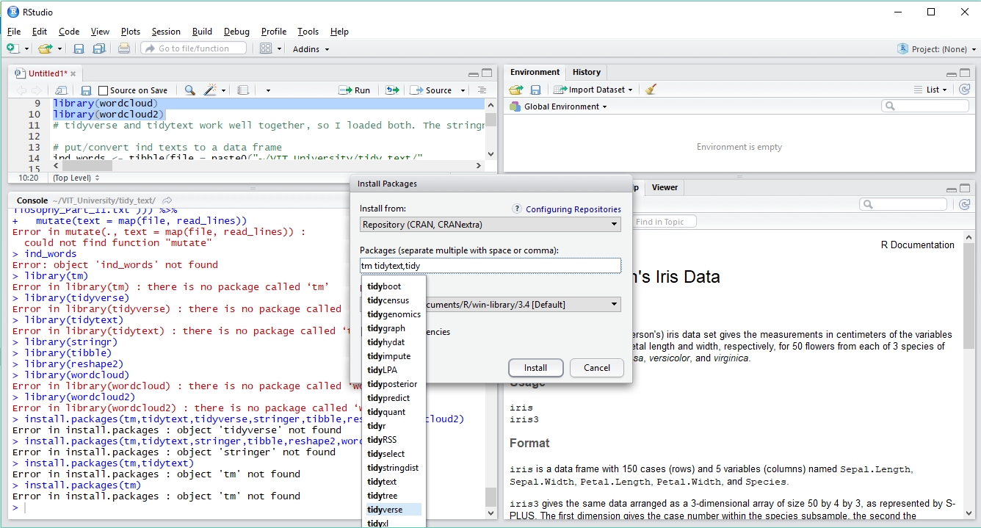
Installing multiple Packages

Slide 13
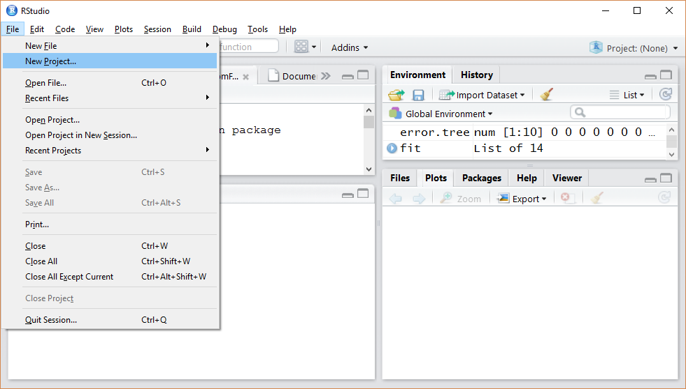
Setting up R Studio

Slide 14
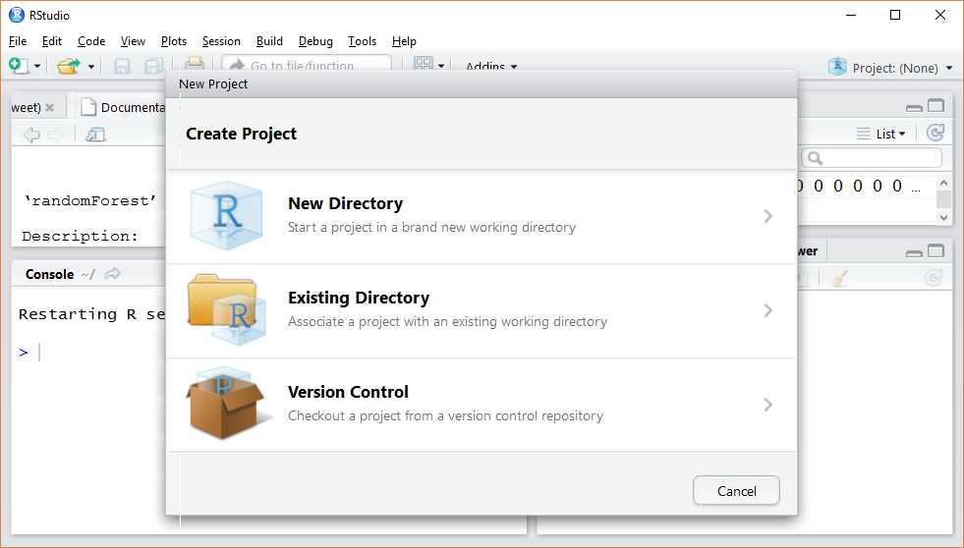
R Projects

Slide 15
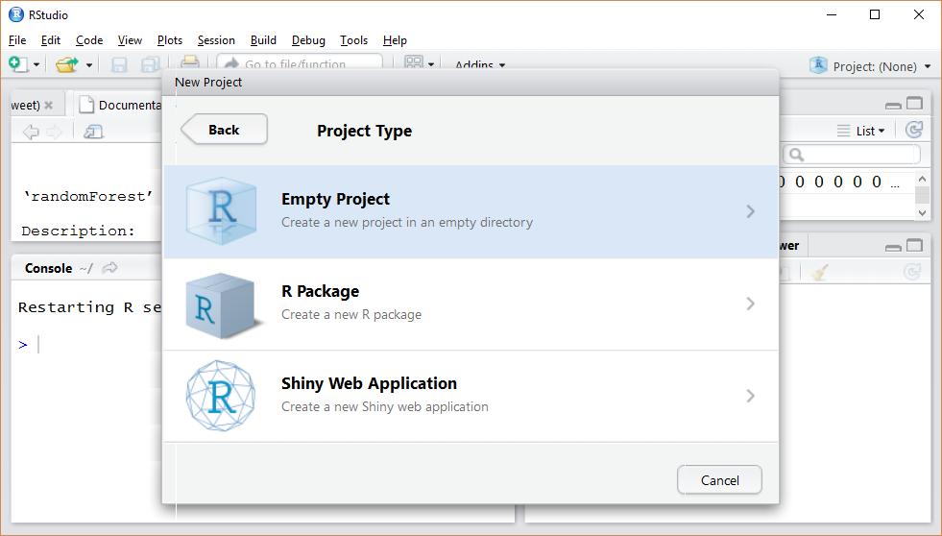

Slide 16
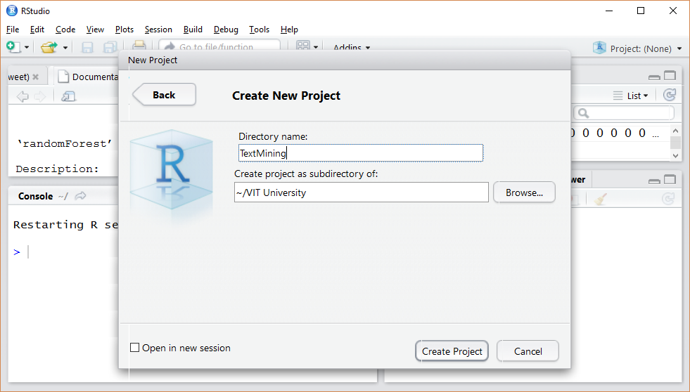

Slide 17
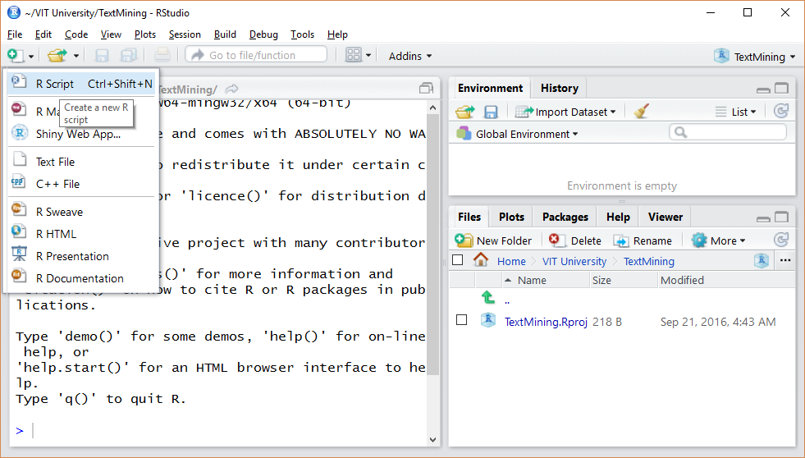

Slide 18
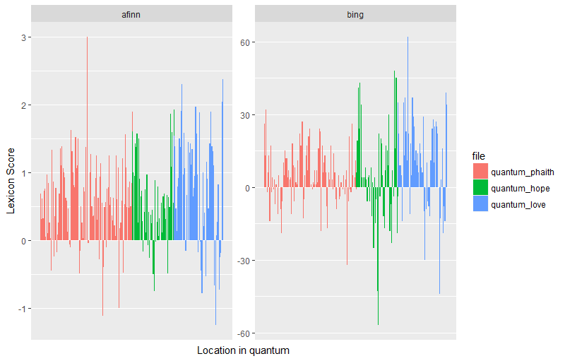
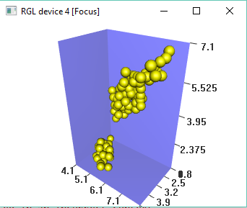
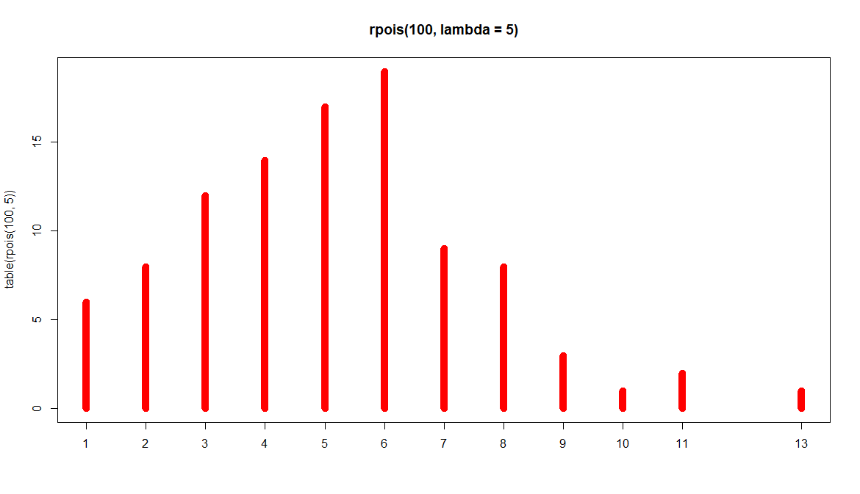
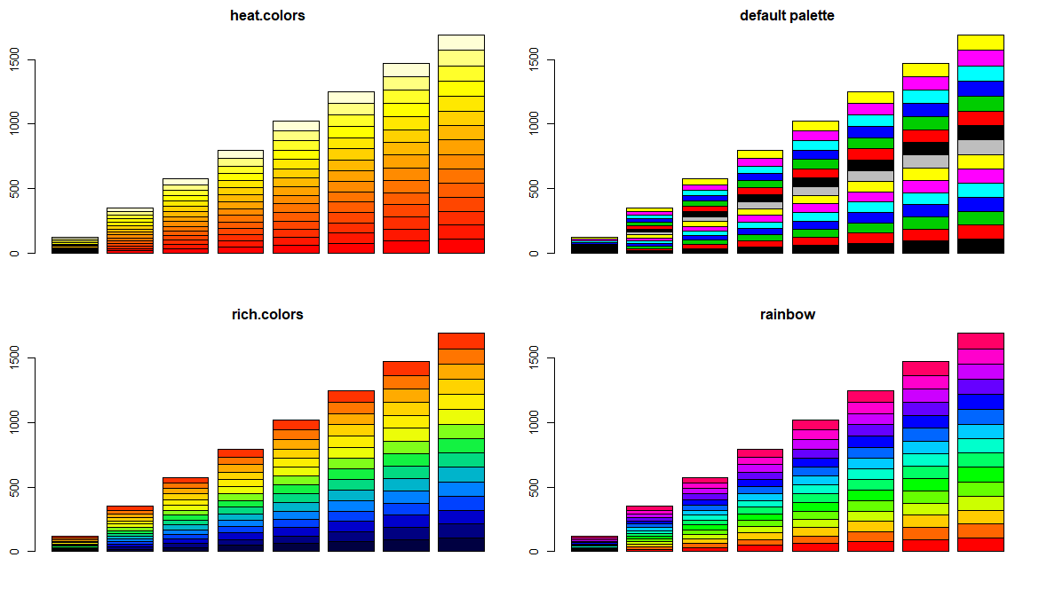
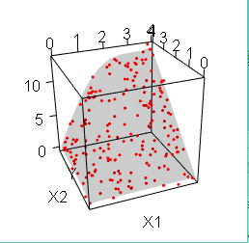
Data Visualization
plot
gplot
ggplot
ggplot2
wordcloud
wordcloud2

Slide 19
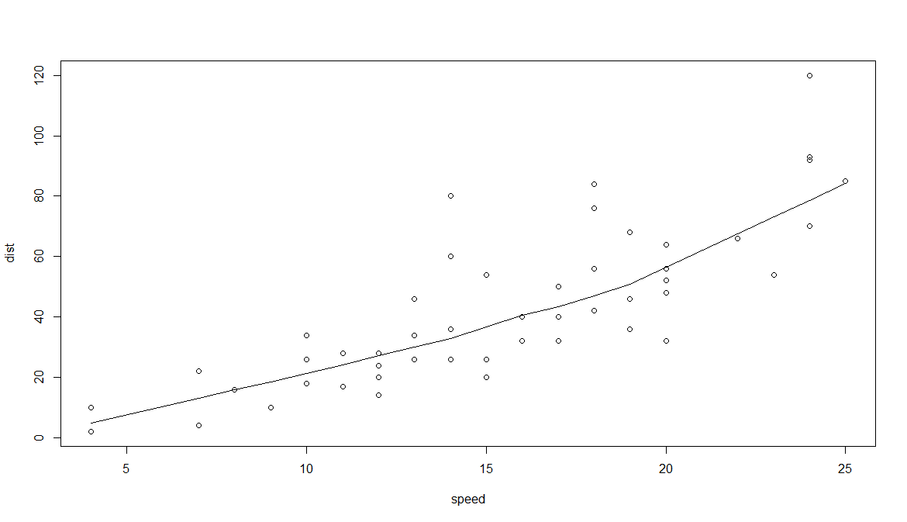
Plot Cars Data
require(stats) # for lowess, rpois, rnorm
plot(cars)
lines(lowess(cars))

Slide 20
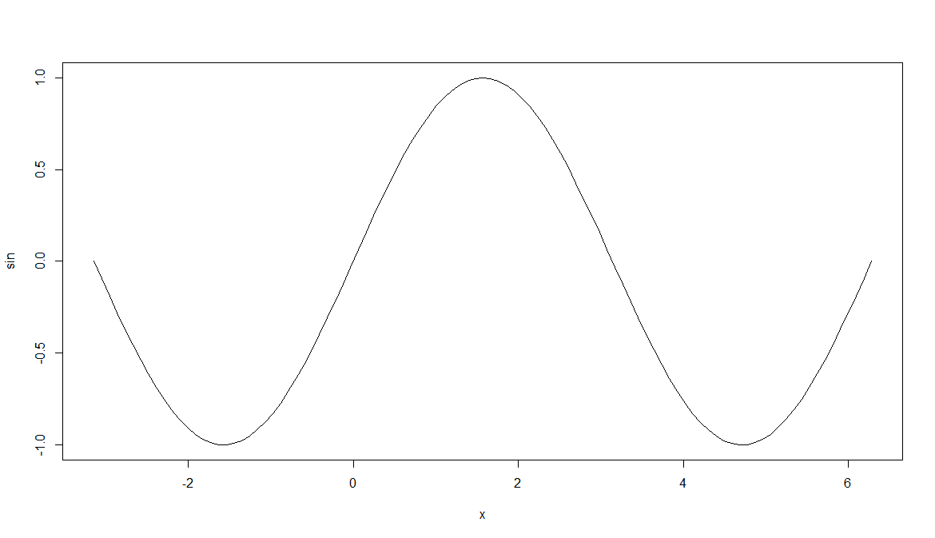
Plot Sine Function
plot(sin, -pi, 2*pi)

Slide 21
Discrete Distribution Plot
plot(table(rpois(100, 5)), type = "h", col = "red", lwd = 10,
main = "rpois(100, lambda = 5)")

Slide 22
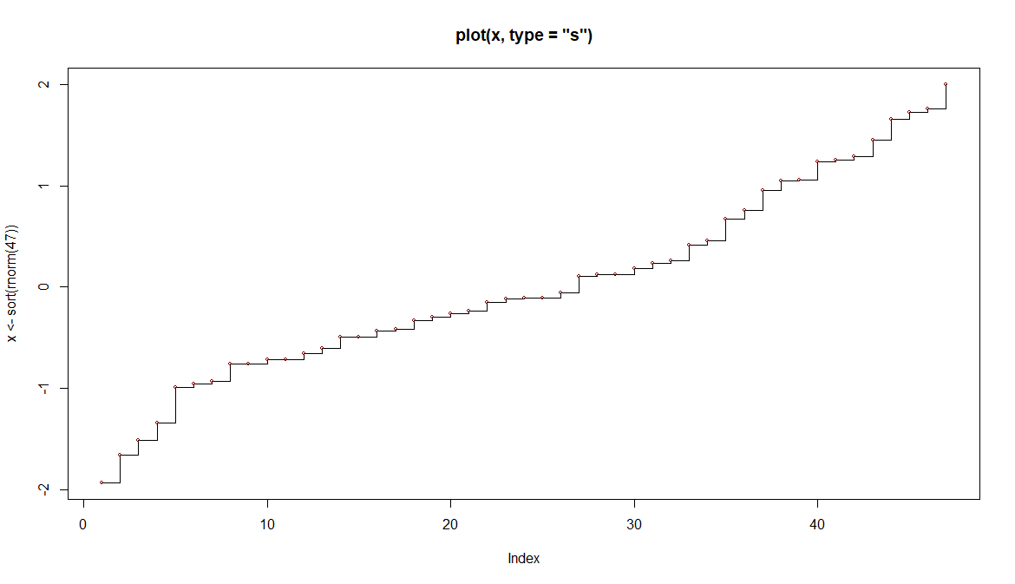
Simple quantiles/ECDF
plot(x <- sort(rnorm(47)), type = "s", main = "plot(x, type = \"s\")")
points(x, cex = .5, col = "dark red")

Slide 23
Rich Colors
m <- abs(matrix(1:120+rnorm(120), nrow=15, ncol=8))
opar <- par(bg="gray", mfrow=c(1,2))
matplot(m, type="l", lty=1, lwd=3, col=rich.colors(8))
matplot(m, type="l", lty=1, lwd=3, col=rich.colors(8,"blues"))
par(opar)
barplot(rep(1,100), col=rich.colors(100), space=0, border=0, axes=FALSE)
barplot(rep(1,20), col=rich.colors(40)[11:30]) # choose subset
plot(m, rev(m), ylim=c(120,0), pch=16, cex=2,
col=rich.colors(200,"blues",alpha=0.6)[1:120]) # semitransparent
rich.colors(100, plot=TRUE) # describe rgb recipe
par(mfrow=c(2,2))
barplot(m, col=heat.colors(15), main="\nheat.colors")
barplot(m, col=1:15, main="\ndefault palette")
barplot(m, col=rich.colors(15), main="\nrich.colors")
barplot(m, col=rainbow(15), main="\nrainbow")
par(opar)

Slide 24
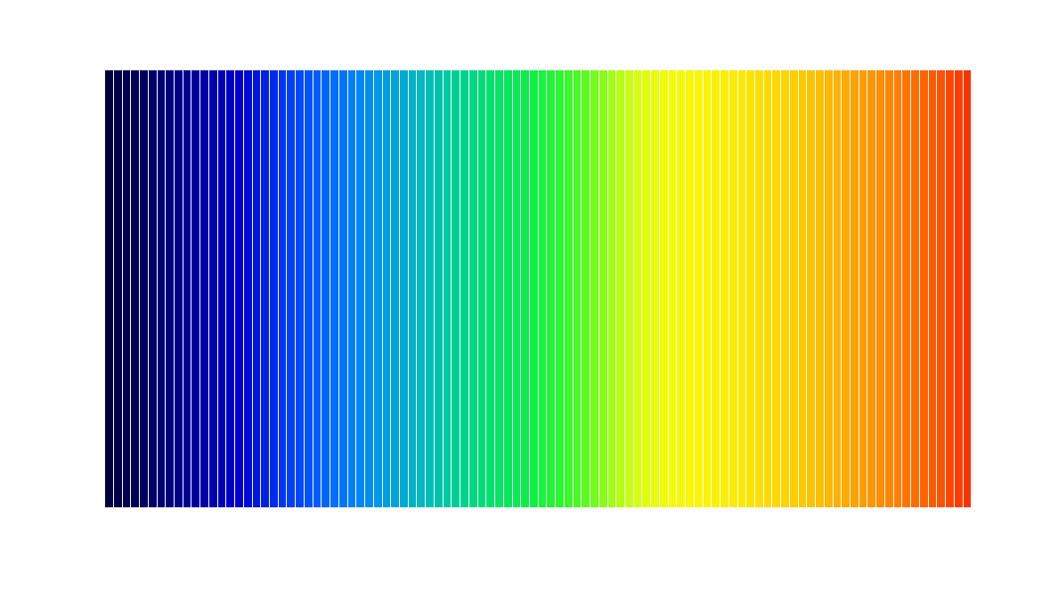
Rich Color Bar Plot
barplot(rep(1,100), col=rich.colors(100), space=0, border=0, axes=FALSE)

Slide 25
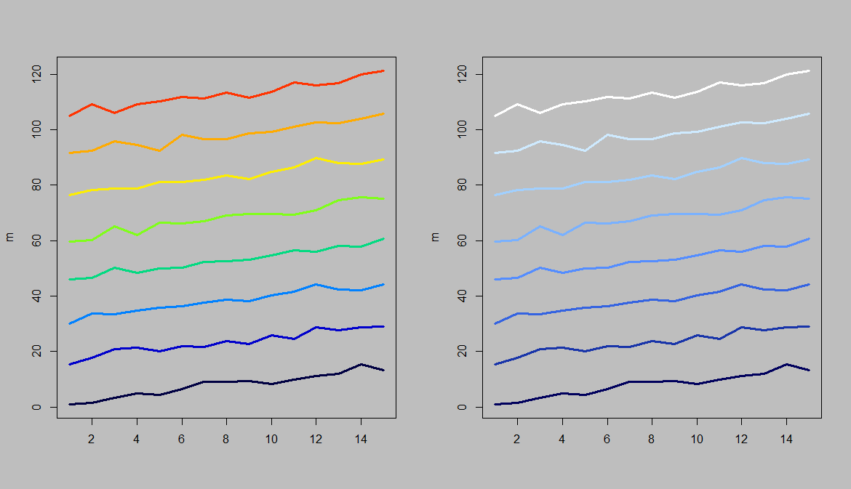
Matrix Plotting
opar <- par(bg="gray", mfrow=c(1,2))
matplot(m, type="l", lty=1, lwd=3, col=rich.colors(8))
matplot(m, type="l", lty=1, lwd=3, col=rich.colors(8,"blues"))
par(opar)

Slide 26
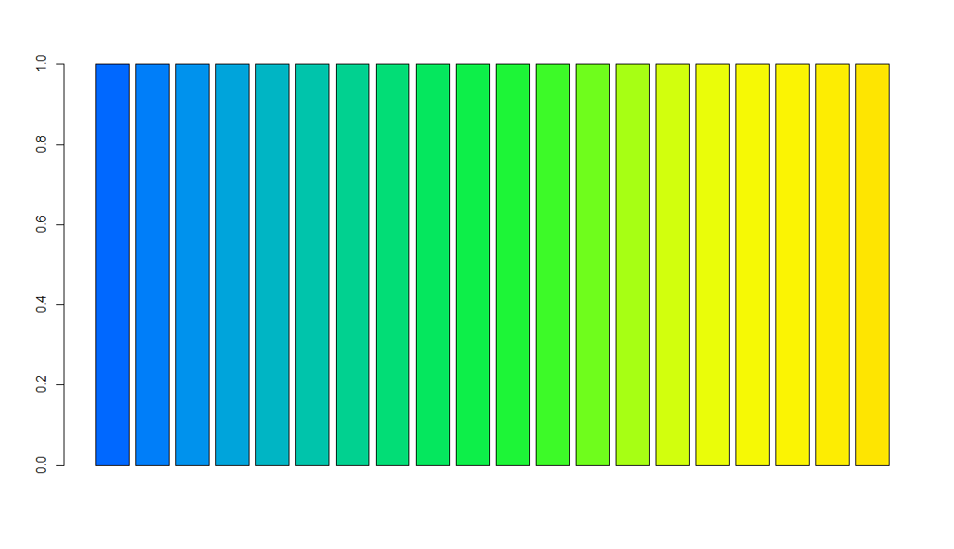
choose subset
barplot(rep(1,20), col=rich.colors(40)[11:30]) # choose subset

Slide 27
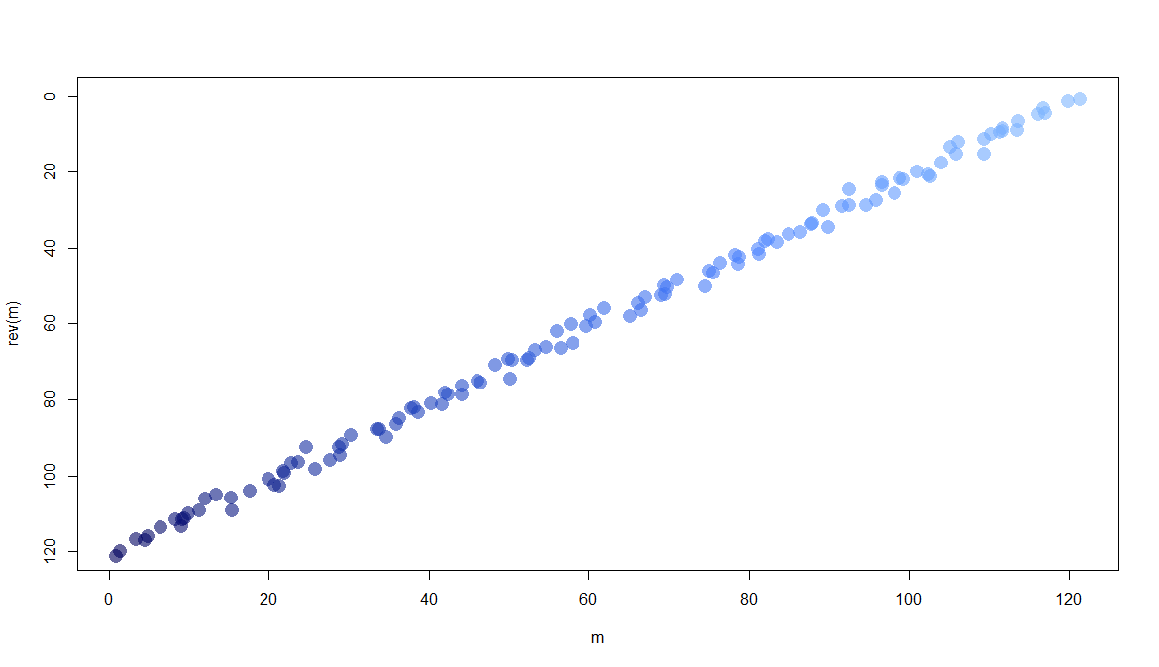
semitransparent
plot(m, rev(m), ylim=c(120,0), pch=16, cex=2,
col=rich.colors(200,"blues",alpha=0.6)[1:120]) # semitransparent

Slide 28
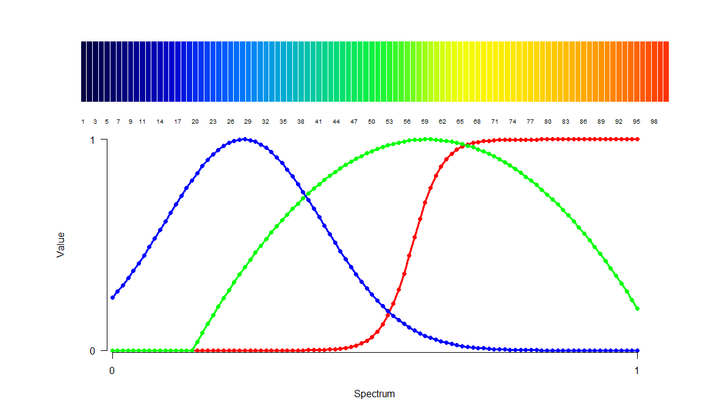
describe rgb recipe
rich.colors(100, plot=TRUE) # describe rgb recipe

Slide 29
Barplots – Various Color Schemes
barplot(m, col=heat.colors(15), main="\nheat.colors")
barplot(m, col=1:15, main="\ndefault palette")
barplot(m, col=rich.colors(15), main="\nrich.colors")
barplot(m, col=rainbow(15), main="\nrainbow")

Slide 30
The rgl package
Title 3D Visualization Using OpenGL
Author Daniel Adler <dadler@uni-goettingen.de>, Duncan Murdoch <murdoch@stats.uwo.ca>, and others (see README) Maintainer Duncan Murdoch <murdoch@stats.uwo.ca>
Depends R (>= 3.2.0)
Suggests MASS, rmarkdown, deldir, orientlib, lattice, misc3d, rstudioapi, magick Imports graphics, grDevices, stats, utils, htmlwidgets, htmltools, knitr, jsonlite (>= 0.9.20), shiny, magrittr, crosstalk, manipulateWidget (>= 0.9.0)
Description Provides medium to high level functions for 3D interactive graphics, including functions modelled on base graphics (plot3d(), etc.) as well as functions for constructing representations of geometric objects (cube3d(), etc.). Output may be on screen using OpenGL, or to various standard 3D ﬁle formats including WebGL, PLY, OBJ, STL as well as 2D image formats, including PNG, Postscript, SVG, PGF.
License GPL
URL https://r-forge.r-project.org/projects/rgl/

Slide 31
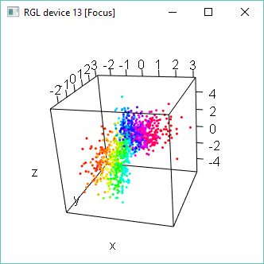
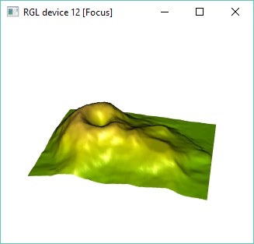
3D real-time rendering system
file.show(system.file("NEWS", package = "rgl"))
example(plot3d)
example(surface3d)

Slide 32
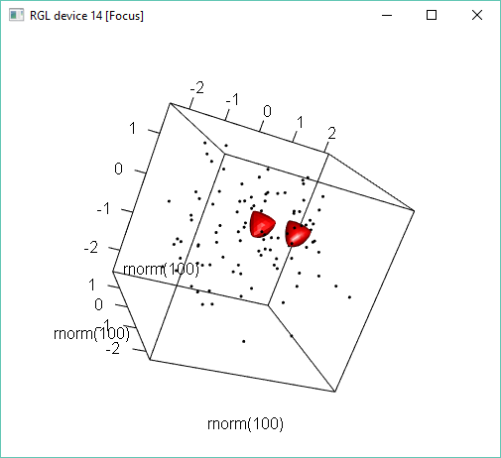
Enhancing a 3d Plot
plot3d(rnorm(100), rnorm(100), rnorm(100))
abclines3d(0, 0, 0, a = diag(3), col = "gray")
open3d()
y <- subdivision3d(tetrahedron3d(col = "red"), depth = 3)
shade3d(y) # No normals
y <- addNormals(y)
shade3d(translate3d(y, x = 1, y = 0, z = 0)) # With normals

Slide 33
Bounding Arrow in A Box
saveopts <- options(rgl.useNULL = TRUE)
theta <- seq(0, 4*pi, len=100)
xyz <- cbind(sin(theta), cos(theta), sin(theta/2))
lineid <- plot3d(xyz, type="l", alpha = 0, lwd = 5, col = "blue")["data"]
widget <- rglwidget() %>%
playwidget(ageControl(births = theta,
ages = c(-4*pi, -4*pi, 1-4*pi, 0, 0, 1),
objids = lineid,
alpha = c(0, 1, 0, 0, 1, 0)),
start = 0, stop = 4*pi,
step = 0.1, rate = 4)
if (interactive())
widget
options(saveopts)

Slide 34
Loading Libraries (Packages)
#!/users/jeff/Documents/VIT_University/tidy_text/Rscript_Indian_Philosophy.r
# Load necessary libraries
library(tm)
library(tidyverse)
library(tidytext)
library(stringr)
library(tibble)
library(reshape2)
library(wordcloud)
library(wordcloud2)
# tidyverse and tidytext work well together, so I loaded both. The stringr package is useful for filtering out the LaTeX specific code and also for dropping words that have numbers in them (like jefferson1776 as a reference or 0.05).

Slide 35
Analyzes Approximately 750,000 words
Indian Philosophy in 2 Volumes, total of 1,200 pages
# put/convert ind texts to a data frame
ind_words <- tibble(file =
paste0("~/VIT_University/tidy_text/",
c("Indian_Philosophy_Part_I.txt",
"Indian_Philosophy_Part_II.txt"))) %>%
mutate(text = map(file, read_lines))
ind_words
# The resulting tibble has a variable file that is the name of the file that created that row and a list-column of the text of that file.

Slide 36
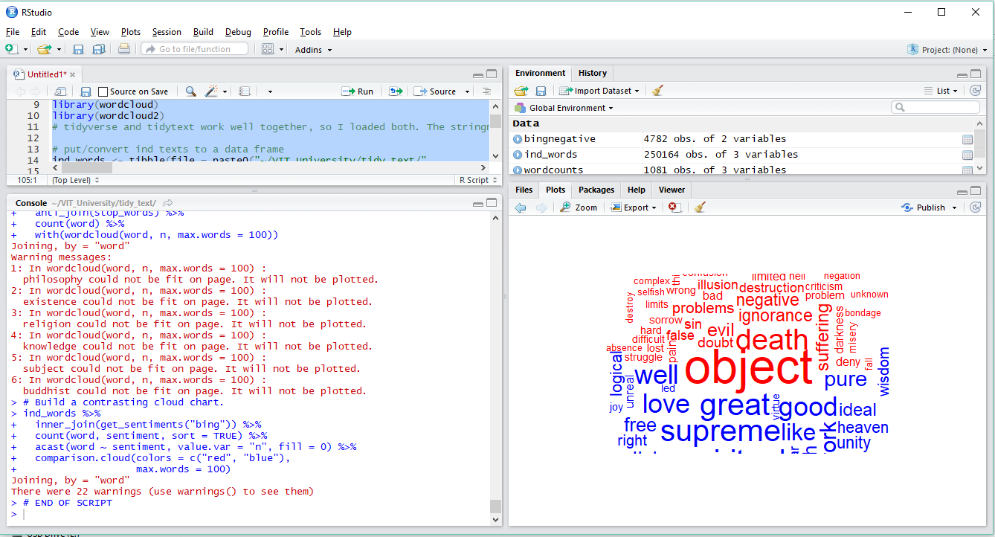
Running a script – Preprogrammed Code

Slide 37
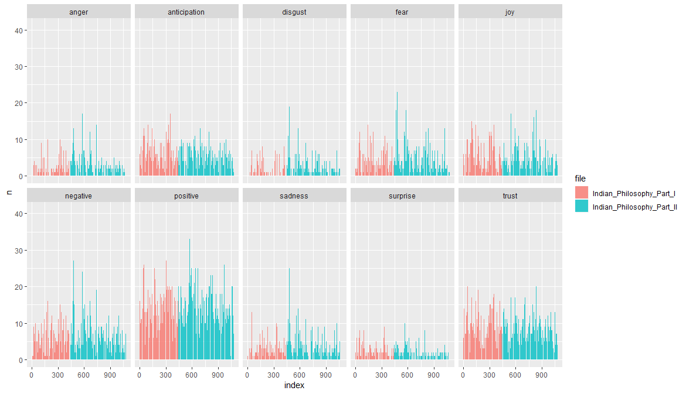
Plotting with ggplot

Slide 38
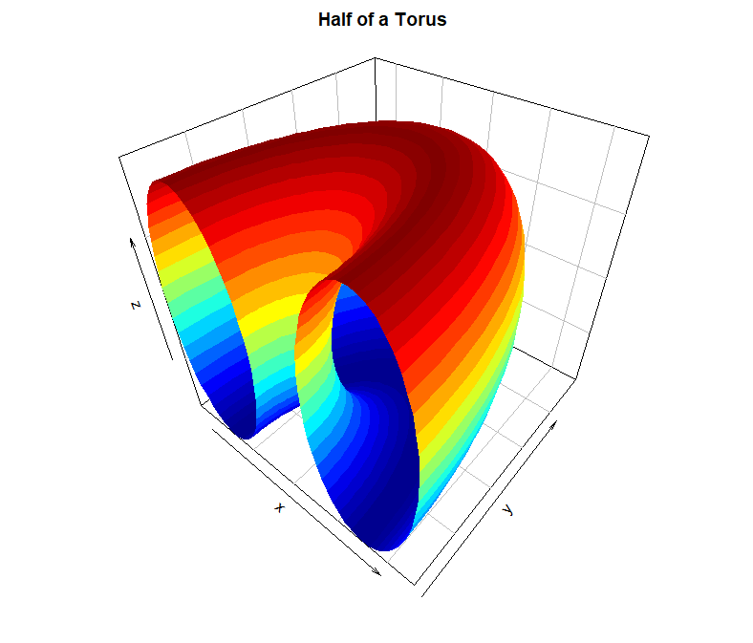
3D Plot of Half of a Torus
# 3D Plot of Half of a Torus
par(mar = c(2, 2, 2, 2))
par(mfrow = c(1, 1))
R <- 3
r <- 2
x <- seq(0, 2*pi,length.out=50)
y <- seq(0, pi,length.out=50)
M <- mesh(x, y)
alpha <- M$x
beta <- M$y
surf3D(x = (R + r*cos(alpha)) * cos(beta),
y = (R + r*cos(alpha)) * sin(beta),
z = r * sin(alpha),
colkey=FALSE,
bty="b2",
main="Half of a Torus")

Slide 39
Contact Information
E-mail: jeff@humalytica.com
LinkedIn: https://www.linkedin.com/in/jeffreystrickland
Web site: www.humalytica.com
Skype: jeffrey.strickland2

